Slide 1
Quick sort using recursive method
Recursive Algorithm
Example
Quick sort complexity

Slide 2
Recursive Algorithm cont…
QUICKSORT(A, p, r) 1. if p < r 2. q =PARTITION(A, p, r)
3. QUICKSORT(A, p, q-1)
4. QUICKSORT(A, q +1, r)
5. Exit

Slide 3
Recursive Algorithm(partition)
PARTITION(A, p, r)
1. x = A[r]
2. i = p-1
3. for j = p to r – 1
4. if A[j]<=x
5. i=i+1
6. exchange A[i]with A[j]
7. exchange A[i+1] with A[r]
8. return i + 1

Slide 4
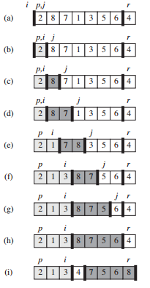
Example:

Slide 5
Complexity of Quick sort
Worst case
O(n²)
Average case
O(n log n)
Best case
O(n log n)

Slide 6
Thank You

